Slide 1
Health Economics
Chapter 4: Efficiency and Cost Benefit Analysis

Slide 2
Cost-Benefit Analysis (CBA)
CBA measures the benefits and costs of projects in money terms
Problem: How to quantify years of life, improvements in health and well-being etc.
Cost-Effectiveness Analysis (CEA) is concerned with finding the best, most efficient, means to implement a project.
Cost-Utility Analysis (CUA) adds measures of individual preferences to CEA.

Slide 3
Cost-Benefit Analysis
CBA analyses is used for projects that have NO market, and therefore no readily available price (e.g. public park, bridges, …)
e.g. immunization programs, heat transplants, patient screening
CBA accounts for indirect benefits and costs (externalities)
B-C>0 implement projects
Rank projects according to: B/C

Slide 4
Determining Costs
Opportunity costs
Infer costs where prices are not readily available
To price new lake view, use existing prices of lake view apartments
Ideally, a dollar should be spent where it does the most good
Reality marginal costs per life saved are hugely different (see Table 4-1 in FGS (2007), page 74)

Slide 5
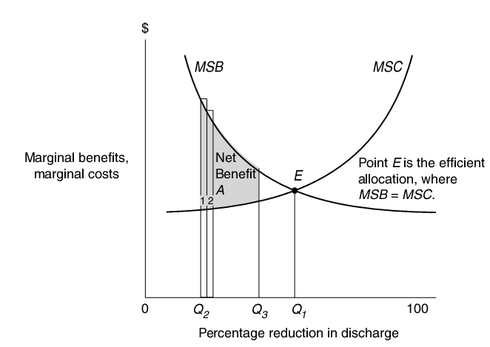
Again: The Marginal Principle MB=MC

Slide 6
Further Issues
Discounting when projects last longer than a period
A dollar today is NOT equal to a dollar tomorrow
“d” is the discount factor – usually 3% in the US
Sometimes we use the market interest rate r
opportunity cost of putting a $ into the project is forgone interest payments
Riskier projects have higher discount factor

Slide 7
Other Issues
Distributional adjustments
Inflation
Value of Human Life
Human Capital Approach: Present value of future earnings
Willingness to Pay Approach
Wide range of estimates from $800,000 to $10 million

Slide 8
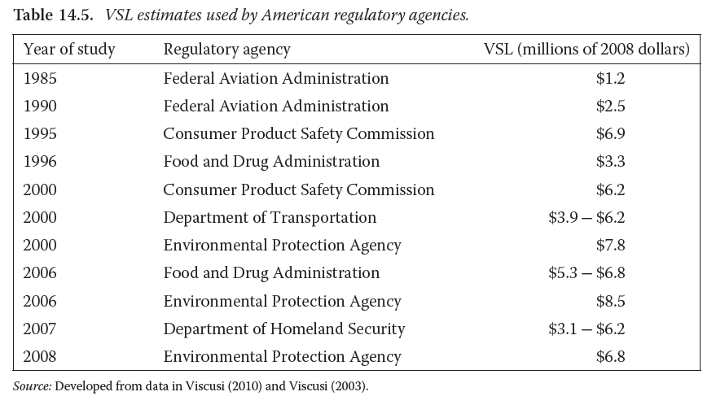

Slide 9
The value of life
NYT, February 17, 2011: http://www.nytimes.com/2011/02/17/business/economy/17regulation.html?_r=2&ref=business&pagewanted=all
How much spending should the government should require to prevent a single death?
The Environmental Protection Agency: value of a life is $9.1 million in 2010 (it was $6.8 million during the Bush administration (2000-2008)).
In December, the E.P.A. said it might set the value of preventing cancer deaths 50 percent higher than other deaths, because cancer kills slowly

Slide 10
The value of life
NYT, February 17, 2011: http://www.nytimes.com/2011/02/17/business/economy/17regulation.html?_r=2&ref=business&pagewanted=all
The Food and Drug Administration: $7.9 million in 2010, up from $5 million in 2008 (e.g. justify warning labels on cigarette packages)
The Transportation Department: $6 million (e.g. to justify stronger roofs on cars.)
Department of Homeland Security suggested that the value of preventing deaths from terrorism might be 100 percent higher than other deaths

Slide 11
Is the value of life determined by politics?
Roof Strength Controversy:
BUSH
The Bush administration rejected a plan in 2005 to make car companies double the roof strength of new vehicles, which it estimated might prevent 135 deaths in rollover accidents each year
Officials figured that the cost of the roofs would exceed the value of lives saved by almost $800 million:
135 lives — less valuable than the thicker roofs

Slide 12
Is the value of life determined by politics?
Roof Strength Controversy:
OBAMA
The Obama administration raised the value of life figure from $3.5 million to $6.1 million.
New calculations showed that benefits outstripped costs, so they imposed stricter and more expensive roof-strength standard:
135 lives — more valuable than the thicker roofs

Slide 13
Why do we need to know the value of life?
The business community wants regulators to put a dollar value on life to make agencies prove that the benefits of regulations exceed the costs
Some business groups are reconsidering the effectiveness of cost-benefit analysis (CBA) as a check on regulations
Advocates for regulation: “CBA understates both the value of life and the benefits of government oversight.”

Slide 14
CBA and value of life How to do the valuation?
Differences in wages show the value that workers place on avoiding the risk of death!
Companies must pay lumberjacks an additional $1,000 a year to perform work that generally kills one in 1,000 workers
So most Americans would forgo $1,000 a year to avoid that risk

Slide 15
CBA and value of life How to do the valuation?
1,000 Americans will collectively forgo $1 million to avoid the same risk entirely. That number is said to be the “statistical value of life.”
According to this scheme the value of life is around $8.7 million in current dollars (using a wider bundle of wage differences)

Slide 16
CBA and value of life How to do the valuation?
Other methods include:
Surveys asking Americans how much they would spend to avoid a given risk.
Tends to produce significantly lower results
Older technique, which yields even lower numbers:
sum the wages lost when a worker dies

Slide 17
The Food and Drug Administration (FDA)
A rule in 2009 requiring new warning labels on packages and bottles of acetaminophen and other drugs was justified by a value of life of $5 million
A few months later, the agency acknowledged that it had calculated the cost of adding ONE new label, while requiring TWO new labels
However, the benefits still exceeded the costs because the value of life was actually $7 million
A few months later, in an unrelated rule regarding salmonella, the agency once again cited a value of $5 million, which it said best reflected the available research
And in its recent study on cigarette labels, the agency cited a value of life of $7.9 million

Slide 18
And the conclusion is?
?? “This administration utilizes the best available science in assessing the benefits and costs of any potential regulation, drawing on widely accepted methodologies that have been in use for years,” (Office of Management and Budget, which oversees the rule-making process)

Slide 19
And the conclusion is?
Politics frequently trumps economics !
Putting a price tag on life is still worthwhile, to help politicians choose among priorities and to shape the details of their proposals

Slide 20
Example: CBA of Disease-Screening Programs
Costs
Screening costs,
time costs, treatment costs,
treatment costs of false positive patients
Benefits
Improved treatment from early detection,
reduction of future cost,
value of reassurance from negative tests (e.g. negative HIV test),
externality from preventing spread of disease, etc.

Slide 21
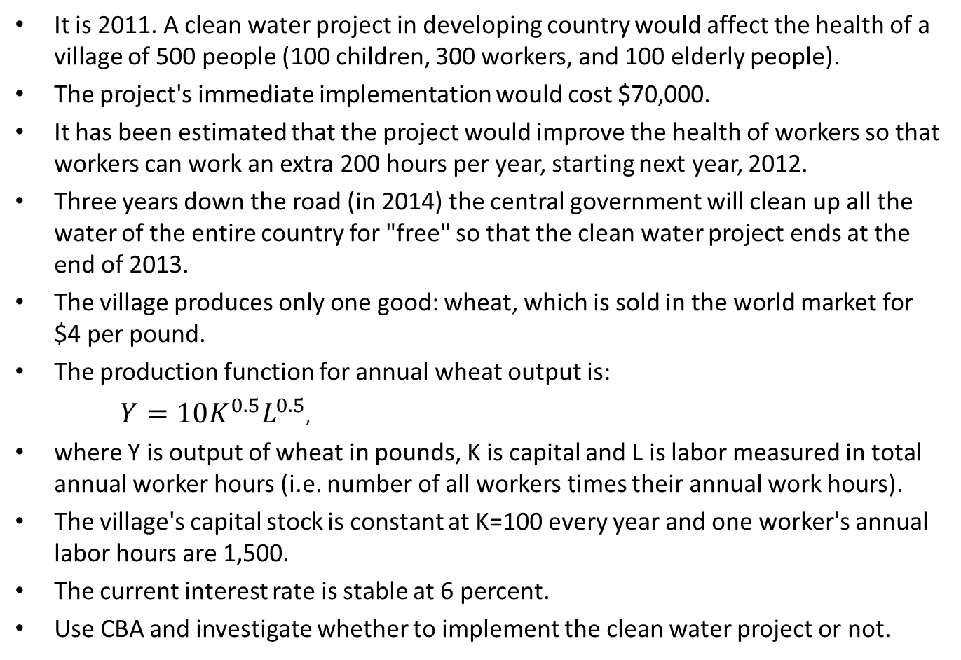
Case Study: Clean Water Project
It is 2011. A clean water project in developing country would affect the health of a village of 500 people (100 children, 300 workers, and 100 elderly people).
The project's immediate implementation would cost $70,000.
It has been estimated that the project would improve the health of workers so that workers can work an extra 200 hours per year, starting next year, 2012.
Three years down the road (in 2014) the central government will clean up all the water of the entire country for "free" so that the clean water project ends at the end of 2013.
The village produces only one good: wheat, which is sold in the world market for $4 per pound.
The production function for annual wheat output is:
$Y=10K^{0.5}L^{0.5}$,
where Y is output of wheat in pounds, K is capital and L is labor measured in total annual worker hours (i.e. number of all workers times their annual work hours).
The village's capital stock is constant at K=100 every year and one worker's annual labor hours are 1,500.
The current interest rate is stable at 6 percent.
Use CBA and investigate whether to implement the clean water project or not.

Slide 22
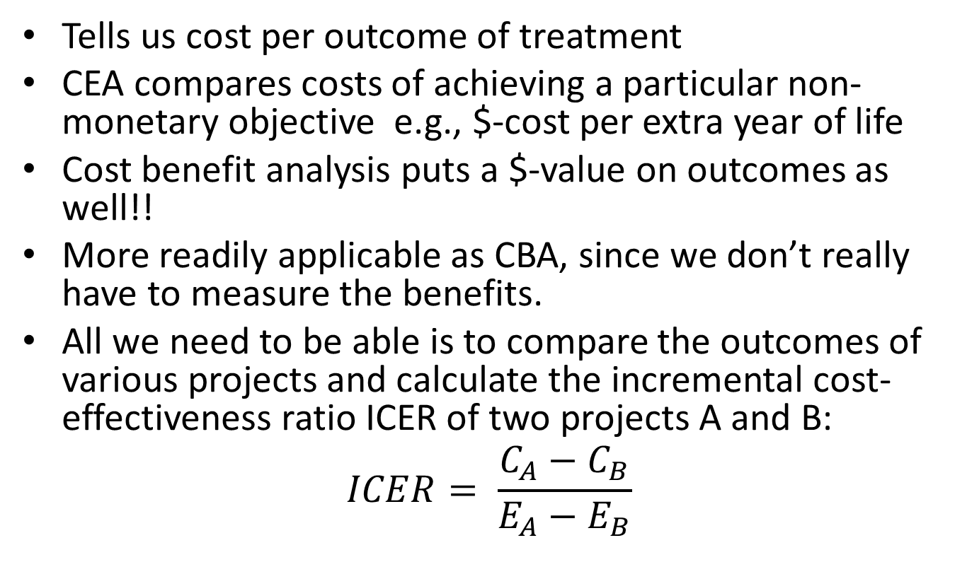
Cost-Effectiveness Analysis (CEA)
Tells us cost per outcome of treatment
CEA compares costs of achieving a particular non-monetary objective e.g., $-cost per extra year of life
Cost benefit analysis puts a $-value on outcomes as well!!
More readily applicable as CBA, since we don’t really have to measure the benefits.
All we need to be able is to compare the outcomes of various projects and calculate the incremental cost-effectiveness ratio ICER of two projects A and B:
$$ICER= \frac{C_{A}−C_{B}}{E_{A}−E_{B}}$$

Slide 23
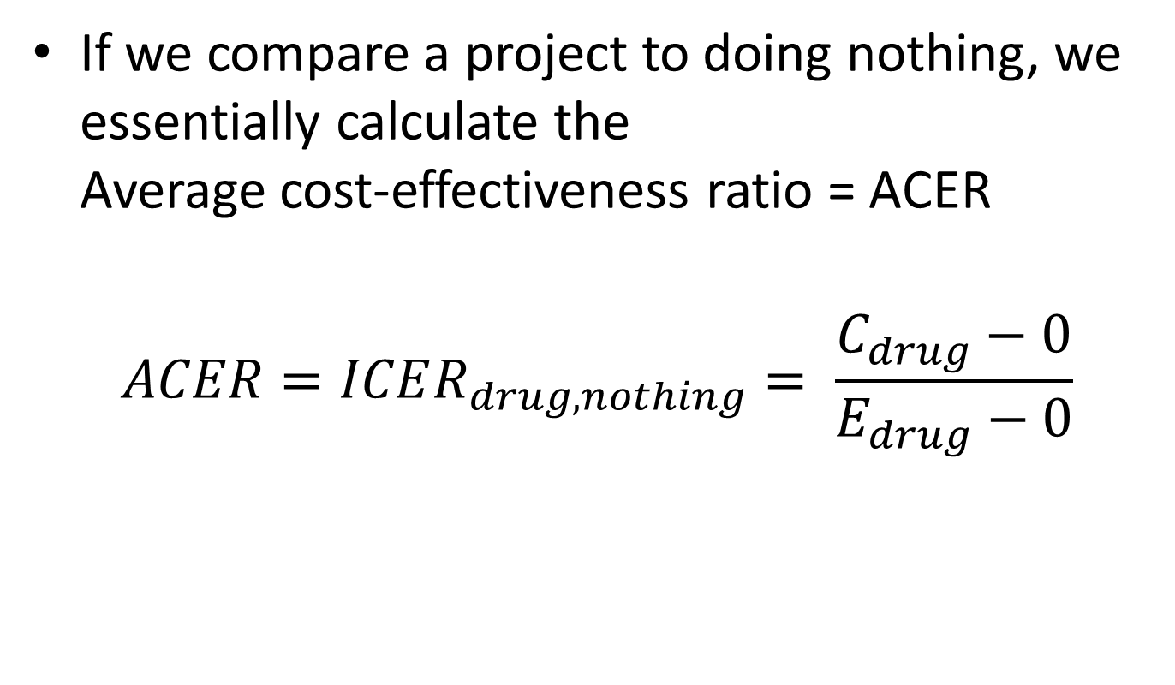
Incremental Cost-Effectiveness Ratio (ICER)
If we compare a project to doing nothing, we essentially calculate the Average cost-effectiveness ratio = ACER
$$ACER=ICER_{drug,nothing}= \frac{C_{drug}−0}{E_{drug}−0}$$

Slide 24
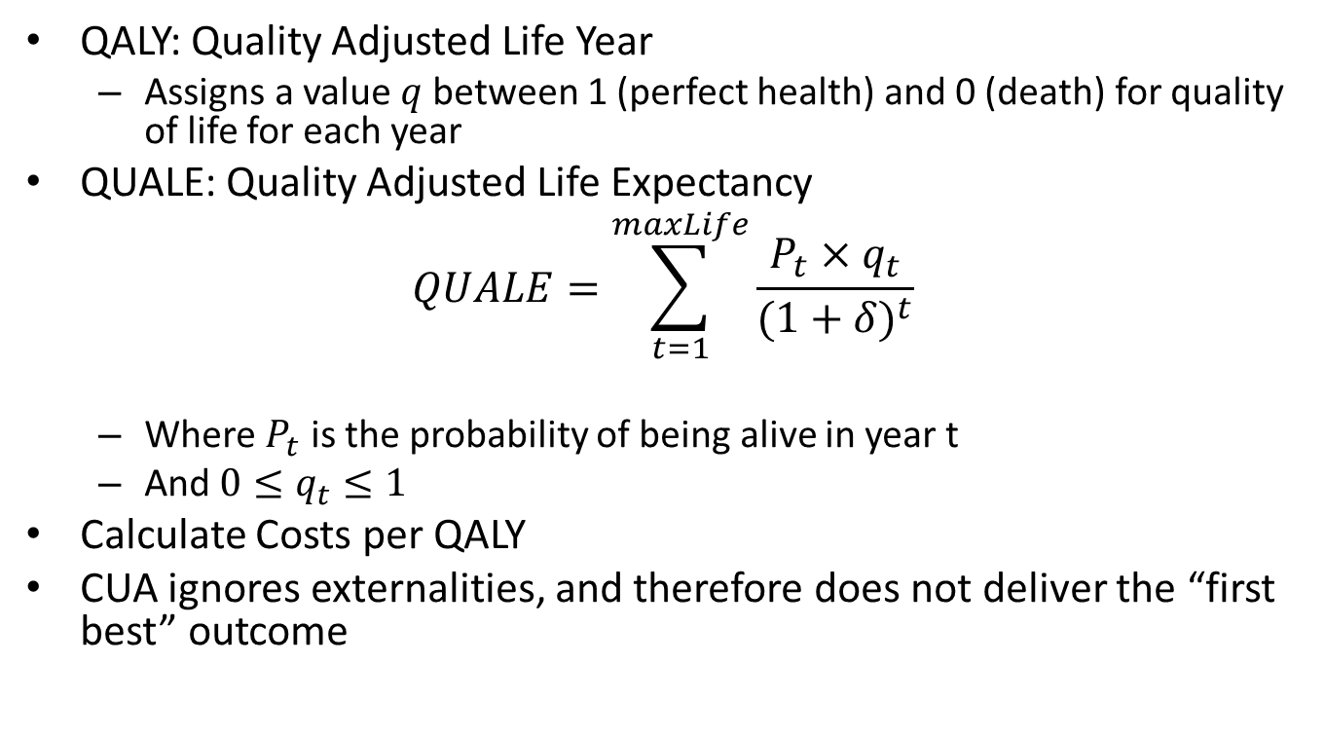
Cost-Utility Analysis (CUA)
QALY: Quality Adjusted Life Year
Assigns a value $q$between 1 (perfect health) and 0 (death) for quality of life for each year
QUALE: Quality Adjusted Life Expectancy
$$QUALE=\sum_{t=1}^{maxLife}{\frac{P_{t}×q_{t}}{({1+δ)}^{t}}}$$
Where $P_{t}$ is the probability of being alive in year t
And $0≤q_{t}≤1$
Calculate Costs per QALY
CUA ignores externalities, and therefore does not deliver the “first best” outcome

Slide 25
Issues with QALY
Places a reduced value on older people
Fewer life years, lower quality coefficient.
Fairness question
DALY – Disability-Adjusted Life Years puts more weight to middle aged group
Middle aged care for the very young and the very old
Hump shaped set of quality weights

